Slide 1

Chef 101
Raghu

Slide 2
Objectives
Hello and welcome to the beginning of your journey of learning about Chef Software. This course was designed for people who are new to Chef Software.
After completing this course, you should be able to:
Define IT Automation
List some of Chef Software's customers
Explain what some Chef Automation products and solutions do
Explain where Chef Software fits Into DevSecOps

Slide 3
About Chef Software
Chef Software was founded in 2008. Our first product was called Chef (now called Chef Infra) which is a set of tools that automate the configuration of your cloud-based or on-prem server infrastructure.
Chef can automate how you build, deploy, and manage your infrastructure.
Chef can integrate with cloud-based platforms such as Microsoft Azure, Google Cloud, and Amazon Web Services (AWS) to automatically provision and configure those cloud-based computing resources.
For example, say a large retailer needs to deploy and configure 50 servers for an upcoming sale. They could use Chef Infra to automate that infrastructure deployment.

Slide 4

Chef Progress
In October 2020, Chef Software was acquired by Progress Software and Chef Software operates as a business unit of Progress Software. Chef Software has been and still is a leader in DevOps and DevSecOps.

Slide 5
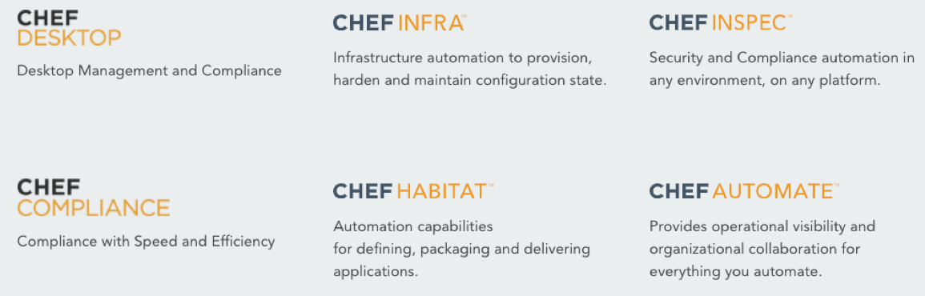
Chef Software Products
Over time, Chef Software's product offerings have grown to include many IT automation products, such as these:

Slide 6
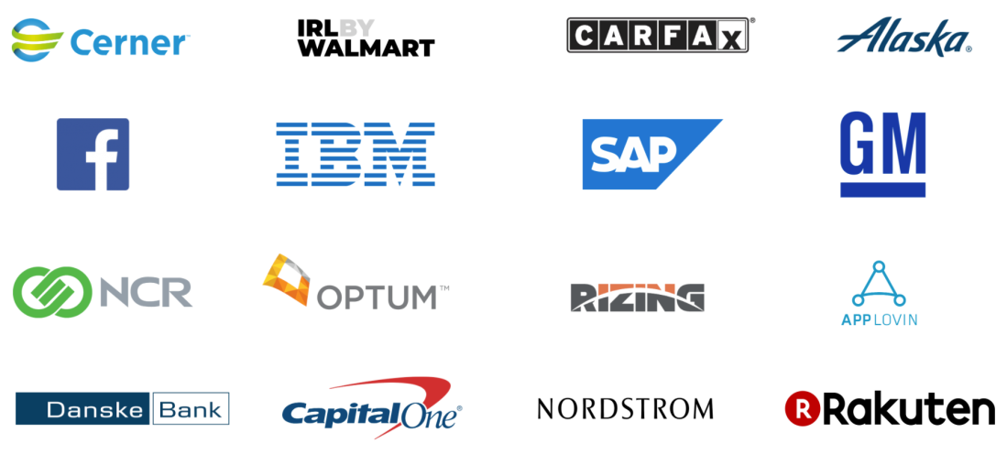
Chef Client List
Chef Software users consist of hundreds of small businesses to large enterprises such as these:
Most of Chef's customers come from Fortune 1000 companies, including major organizations like Facebook, Nordstrom, Disney, and General Electric

Slide 7
Introduction to Automation
Automation is the act of building a process that will operate without human intervention. At Chef Software, it means automating the configuration and management of cloud-based or on-premises computing infrastructure.

Slide 8

First off, what is infrastructure?

Slide 9
What is Automation?
Building a process that will operate without human intervention.
repetitive tasks, with consistency and reliability.
It is not about replacing human operators
In addition, the use of automation,

Slide 10
Infrastructure Automation
Infrastructure Automation refers to ensuring every system is configured correctly and consistently in any cloud, VM, and/or physical infrastructure, in an automated fashion.
At Chef Software, Infrastructure Automation typically begins with using the Chef Infra product and its tools. Chef Infra is included in the Chef Workstation package and is typically installed on your local workstation.
A Chef cookbooks as a set of configuration files, called recipes, that will instantiate, configure, and maintain your infrastructure nodes in an automated fashion
The Chef Infra server in turn loads those cookbooks to the correct nodes.

Slide 11
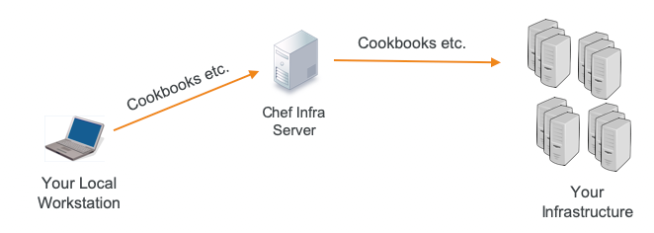
The Chef Infra product is an open source technology that uses Ruby to develop basic building blocks like Chef recipes and cookbooks that configure and maintain your infrastructure. Chef Infra helps in reducing manual and repetitive tasks for infrastructure management.

Slide 12
An example of a Chef Infra recipe
package 'httpd'
template '/var/www/html/index.html' do
source 'index.html.erb'
end
service 'httpd' do
action [:enable, :start]
end
install an Apache web server package (httpd)
create a file on that node called /var/www/html/index.html
enable and start the Apache web server

Slide 13
Compliance Automation
Compliance automation refers to automatically ensuring your infrastructure complies with security standards set by authorities such as the Center for Internet Security (CIS) https://www.cisecurity.org/.

Slide 14
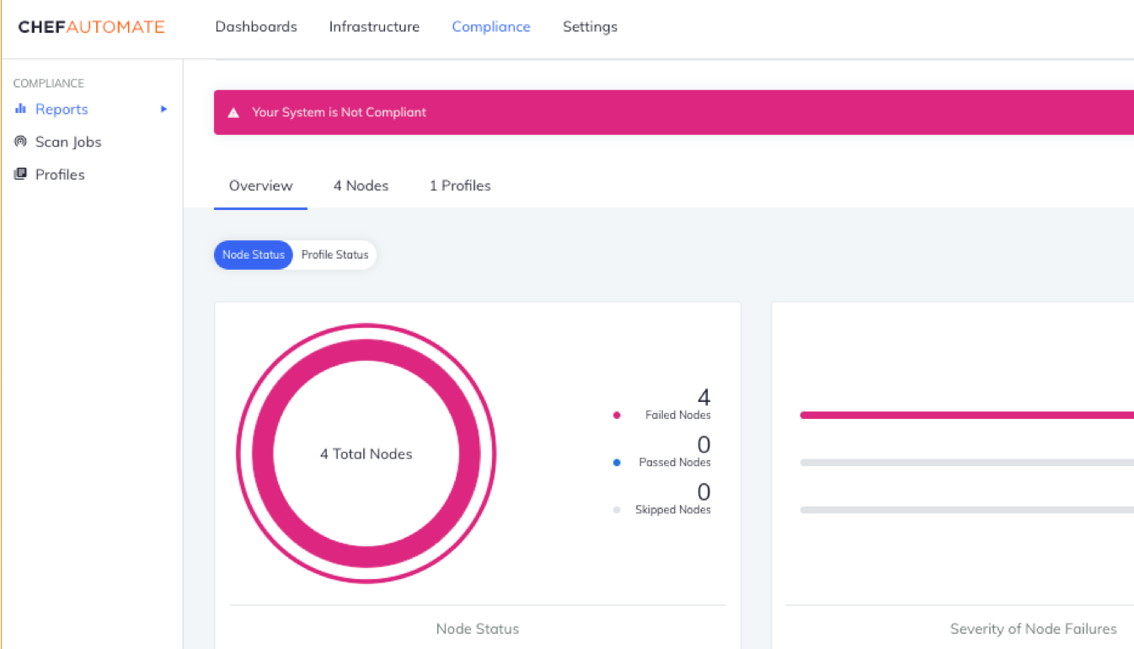
Compliance Automation

Slide 15
Chef Compliance
scan your infrastructure to identify and report security compliance issues
Chef InSpec language

Slide 16
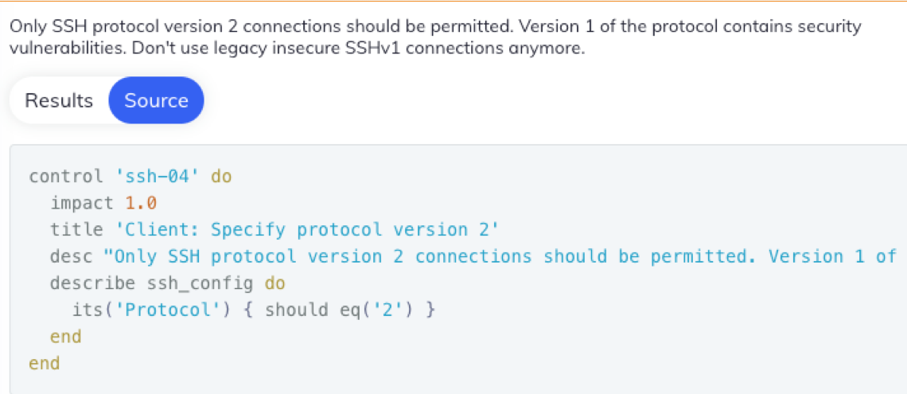
Below is an example of the Chef InSpec language

Slide 17
Application Automation
Application Automation refers to defining, packaging and delivering applications to almost any environment regardless of operating system or deployment platform. At Chef, the Chef Habitat solution enables DevOps and application teams to:
Build continuous delivery pipelines across all applications and all change events
Create artifacts that can be deployed on-demand to bare-metal, VMs, or containers without any rewriting or refactoring
Scale the adoption of agile delivery practices across development and operations

Slide 18
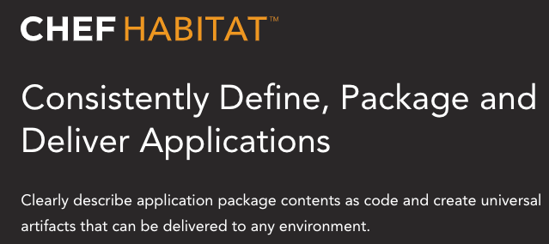
Application Automation

Slide 19
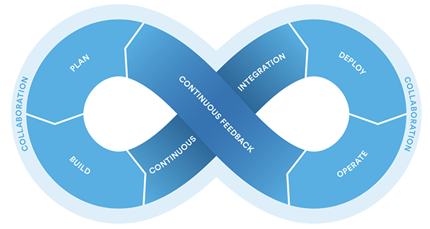
Where Chef Software Fits Into DevSecOps
First off, what is DevOps?

Slide 20
What is DevSecOps?
DevSecOps is an augmentation of DevOps to allow for security practices to be integrated into the DevOps approach.

Slide 21
Where Chef Software Fits Into DevSecOps
Infrastructure-as-code realm.
Dev, Ops and Security teams
Chef Enterprise Automation Stack (EAS).

Slide 22
Chef Open Source Software
Open Source Software at Chef are Chef Infra, Chef InSpec, Chef Habitat, Chef Workstation and Chef Automate.
Each of these automation tools is fully open source and comprised of one or more open source projects
All Chef projects operate under governance determined by the Chef OSS Practices Committee

Slide 23
Chef Infra
Chef Infra is a powerful automation platform that transforms infrastructure configuration into code.
At the heart of this tool is the Chef Infra Client, which typically runs as an agent on the systems managed by Chef.

Slide 24
There are many available patterns when using Chef Infra as an individual tool, but it can be particularly powerful with combined with other automation tools.
Below is a sample of how Chef Infra is used to deploy a policy set to an acceptance environment.
~/chef-repo> chef push acceptance policyfiles/company_web.lock.json
Uploading policy company_web (1e97a11553) to policy group acceptance
Using apache 0.1.0 (1388ab3a)
Using chef-client 11.5.0 (7cb128f1)
Using company_web 0.1.0 (085c5742)
Using cron 6.2.2 (602e43b3)
Using logrotate 2.2.2 (bd20a5c5)
Using mychef_client 0.1.0 (f79fa661)
Using myiis 0.2.2 (c7630da4)

Slide 25
Chef InSpec
Chef InSpec provides a language for describing security and compliance rules that can be shared between software engineers, operators, and security engineers.
Security controls from scratch.

Slide 26
Example:
Here is an example of the InSpec language.
control 'tmp-1.1' do
impact 0.3 title
'/tmp directory is owned by the root user'
desc 'The /tmp directory must be owned by the root user'
describe file('/tmp') do
it { should be_owned_by 'root' }
end
end

Slide 27
Chef Habitat
Chef Habitat is an open source automation solution for defining, packaging, and delivering applications to almost any environment regardless of operating system or platform.
Plan file.
Habitat allows for application automation to live alongside the app's source code.

Slide 28
Example
Here's some sample output from the packaging process when building a Habitat Artifact file.
[4][default:/src:0]# build : Loading /src/habitat/plan.sh
meme-machine: Plan loaded
meme-machine: Validating plan metadata
meme-machine: Using HAB_BIN=/hab/pkgs/core/hab/1.6.0/20200420200029/bin/hab for installs, signing, and hashing meme-machine: hab-plan-build setup
meme-machine: Writing pre_build file
mkdir: created directory '/src/results'
meme-machine: Resolving scaffolding dependencies » Installing core/scaffolding-ruby [...] ✓ Installed core/imagemagick/7.0.9-9/20200404072903
★ Install of core/imagemagick/7.0.9-9/20200404072903 complete with 2 new packages installed. [...] meme-machine: I love it when a plan.sh comes together.
meme-machine:
meme-machine: Build time: 1m1s

Slide 29
Chef Workstation
Chef Workstation gives you all the tools you need to get started. You can install Chef Workstation on your laptop/workstation to begin working with Chef software.
bundles together all the common software

Slide 30
Chef Workstation includes:
The Chef Workstation App
Chef Infra Client
Chef InSpec
Chef Command Line Tool

Slide 31
$ chef --version
Chef Workstation version: 20.11.180
Chef Infra Client version: 16.6.14
Chef InSpec version: 4.23.15
Chef CLI version: 3.0.33
Chef Habitat version: 1.6.56
Test Kitchen version: 2.7.2
Cookstyle version: 7.2.1

Slide 32
Test Kitchen
Cookstyle
Plus various Test Kitchen and Knife plugins:
You can download Chef Workstation from https://downloads.chef.io/products/workstation.

Slide 33
Chef Automate
Chef Automate is an enterprise visibility and metrics tool that provides actionable insights for any systems that you manage using Chef tools and products
The goal of Chef Automate is to make infrastructure management, application delivery and continuous compliance realities by enabling cross-team collaboration using a single source-of-truth

Slide 34
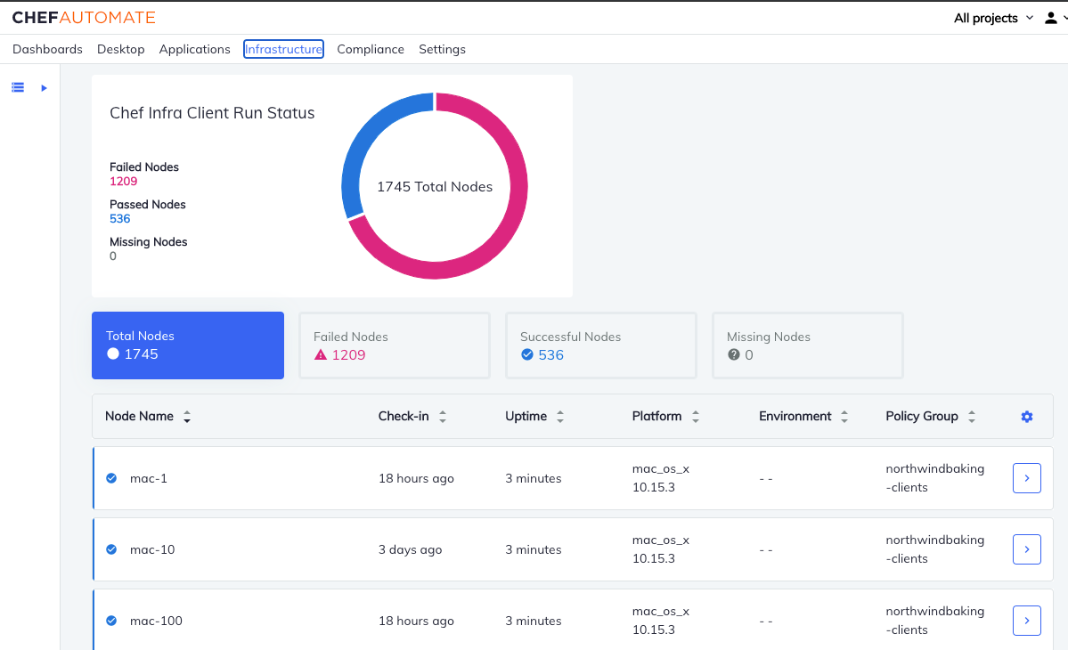
There are many ways to view the information in Chef Automate, such as the event feed on the main dashboards page. All Chef product offerings and solutions discussed in the next section make use of Automate's visibility features. Below you'll see an example of the Infrastructure Dashboard, which is displaying the status of the Chef Infra Client's most recent node details.
Now that we know about Chef Software's open source software, in the next section you will learn how those open source tools comprise Chef solutions and products.

Slide 35
Chef Infrastructure Management
Chef Infrastructure Management ensures configurations are applied consistently in every environment with infrastructure management automation.
Chef Infrastructure Management enables DevOps teams to model and deploy secure and scalable infrastructure automation across any cloud, virtual machine, or physical infrastructure.

Slide 36
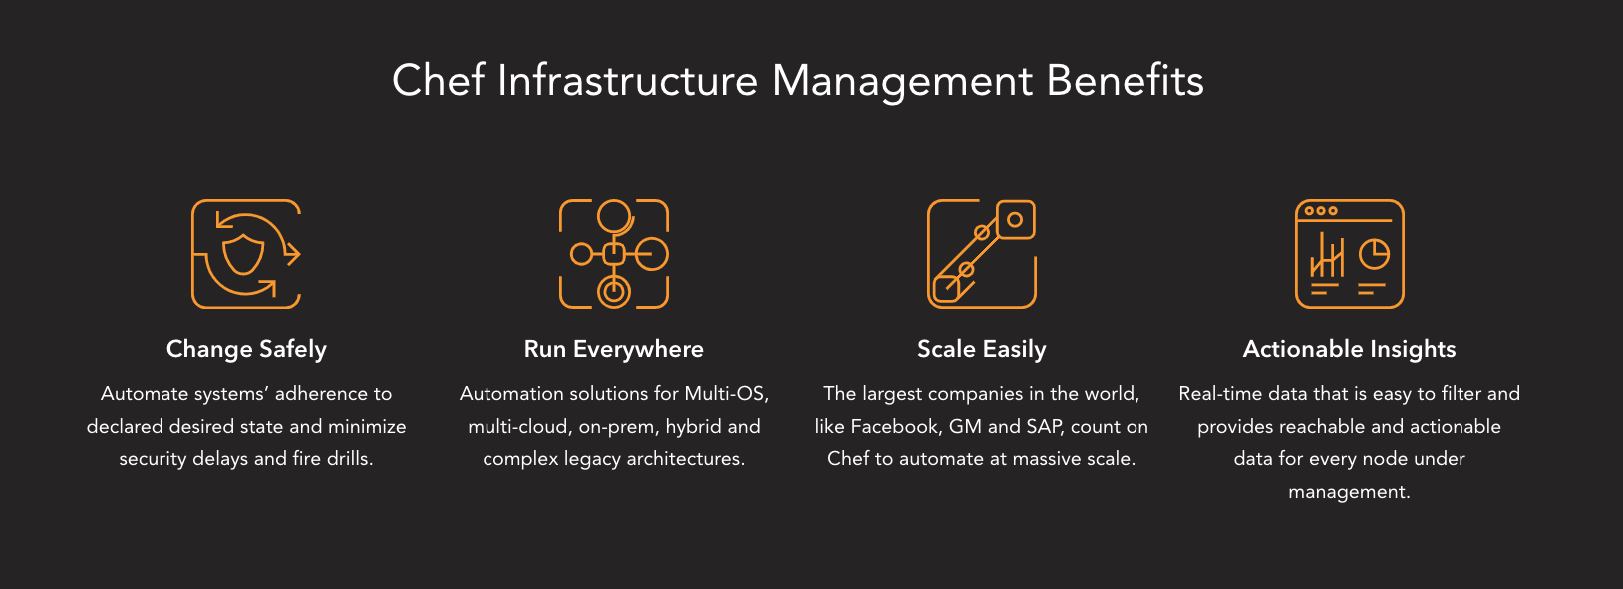
Built on Chef Infra and Chef Automate, Chef Infrastructure Management delivers automation across a wide range of cloud or on-premise infrastructure.

Slide 37
The Chef Infra tool:
Automates the process of managing configurations, ensuring that every system is configured correctly and consistently
Applies updates dynamically, making conditional changes based on running environment or hardware
Ensures that the same code that configures development can be used all the way through to production
Makes infrastructure configurations testable, portable, and auditable
Chef Automate provides operational visibility into the state of your infrastructure at a given moment and through time.

Slide 38
With Chef Automate
Real-Time Data Insights Configuration and compliance details
Collaboration Among Teams Dev, Ops, Security, and Compliance teams
Powerful Auditing Capabilities Create agent-less compliance scans directly in the Web UI.
Ensure the right teams have the right access using existing access control solutions (LDAP/SAML)
Built-In Compliance Assets Leverage pre-created profiles
Actionable Insights at Any Scale A modernized architecture for a responsive, intuitive experience

Slide 39
Chef App Delivery
Deliver successful application outcomes consistently at scale with Chef App Delivery.
Chef App Delivery is an automation solution that enables companies to apply a technology agnostic and modular approach to defining, packaging and delivering application and infrastructure across on-premise, hybrid and cloud environments
Chef Habitat and Chef Infra with Chef Automate

Slide 40
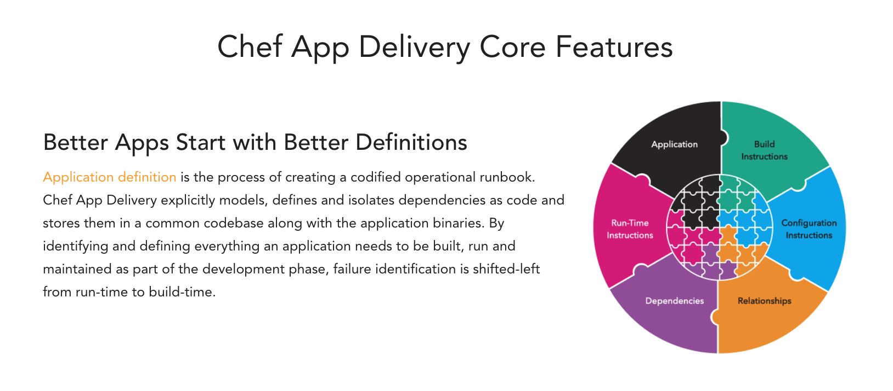
Chef App Delivery

Slide 41
Chef Habitat
Chef Habitat enables DevOps and application teams to build continuous delivery pipelines across all applications and all change events.

Slide 42
Chef Habitat enables:
Application Operations
Agile Development
Cloud Migrations
Continuous Delivery
Edge Computing
DevOps Alignment

Slide 43
Chef Compliance
Chef Compliance makes it easy to maintain and enforce compliance across the enterprise.
Compliance
Audit and remediation content, easily tuned baselines to adapt to the organization’s needs, and visibility and control across hybrid and multi-cloud environments.
These products comprise the Chef Compliance solution:
Auditing with Chef InSpec
Build Compliance Packages with Chef Habitat
Monitor And Report With Chef Automate

Slide 44
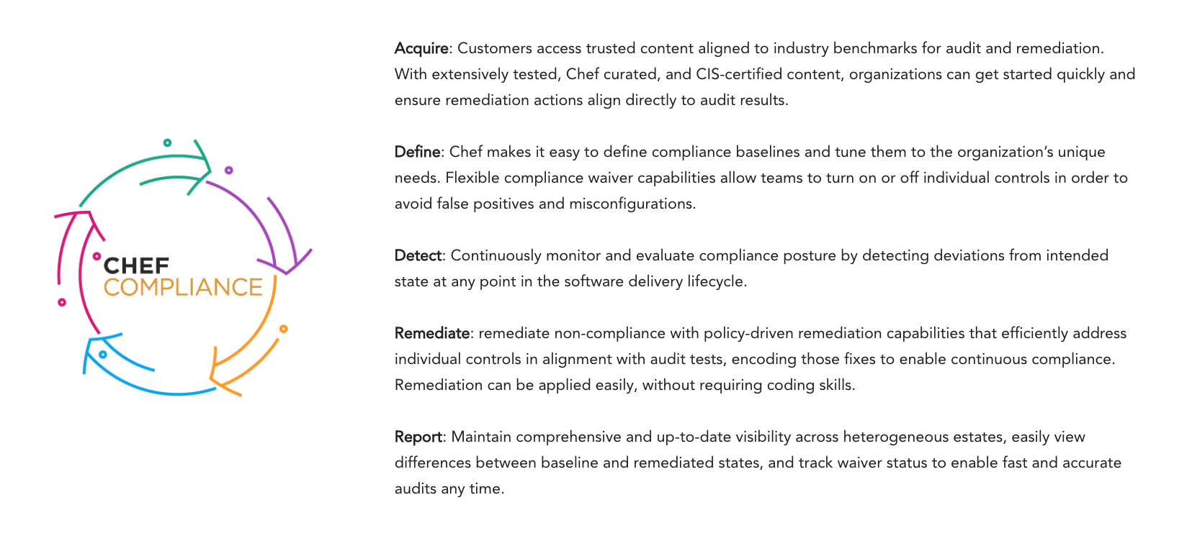
Chef Compliance

Slide 45
It has 2 offerings
The Compliance product has two offerings: Compliance Audit and Compliance Remediation.
Chef Compliance Audit
Chef Compliance Remediation
While the open-source Habitat and InSpec engines
The Chef Automate Compliance Dashboard provides a dedicated view into the state of audits for your fleet at a moment or through time

Slide 46
Chef Desktop
Chef Desktop allows IT teams to automate the deployment, management, and ongoing compliance of IT resources.
Automate the deployment, management, and secure maintenance of laptops, desktops, and kiosk workstations – from a centralized location.

Slide 47
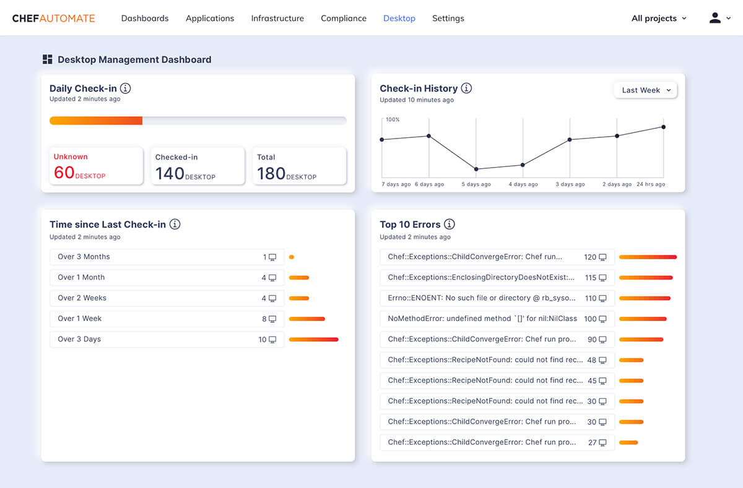
Chef Desktop

Slide 48
Chef Desktop services target the following basic functions:
Hard drive encryption
Screensaver with a password
Password policy to set complexity and other elements
Creating a rescue account or additional user accounts
Application management to deploy and manage apps that you care about
Update management to control where, when, and how OS and related patches are installed
Desktop control to limit access to features or services

Slide 49
Chef Desktop
Under the hood, Chef Desktop is built on Chef Infra with some Azure components. The application of the premium desktop-config Cookbook and the resources it contains allow for advanced configuration of desktop systems that isn't built into Chef Infra directly. Additionally, compliance for desktop systems is also available as a part of service agreements.
Like Chef Infra, Desktop uses Infrastructure as Code to define workstation requirements, so policy can be tracked, versioned, tested and deployed with confidence.

Slide 50
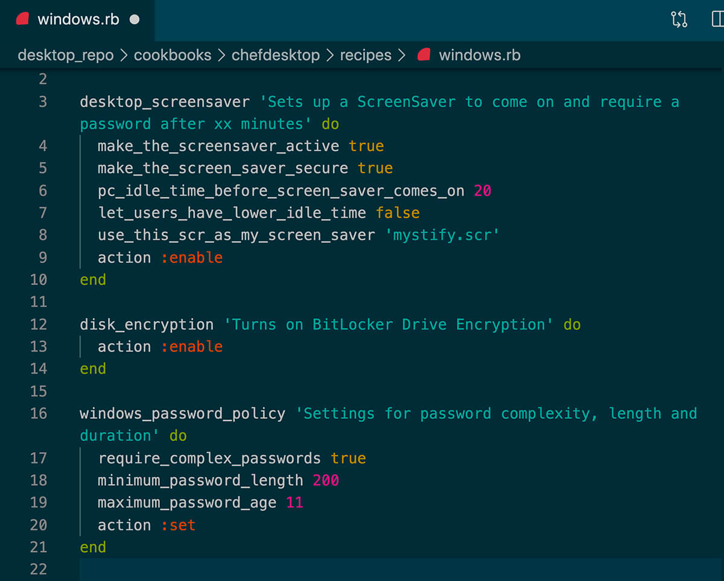
Example

Slide 51
Chef Enterprise Automation Stack
The Chef Enterprise Automation Stack (EAS) is our full suite of enterprise infrastructure, application and DevSecOps automation technologies for delivering change quickly, repeatedly, and securely.

Slide 52
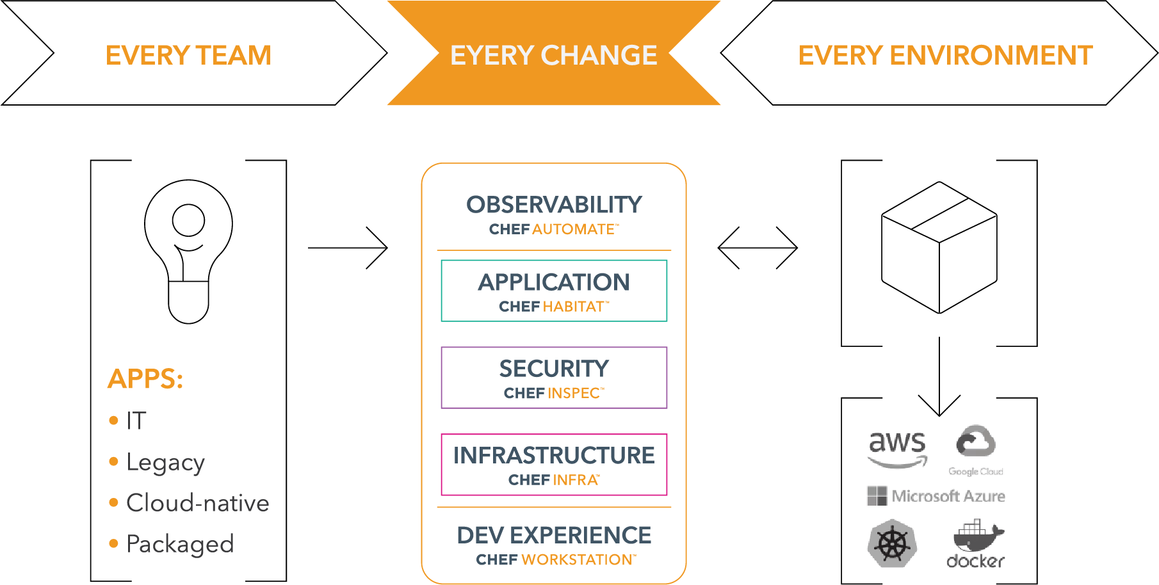
EAS

Slide 53
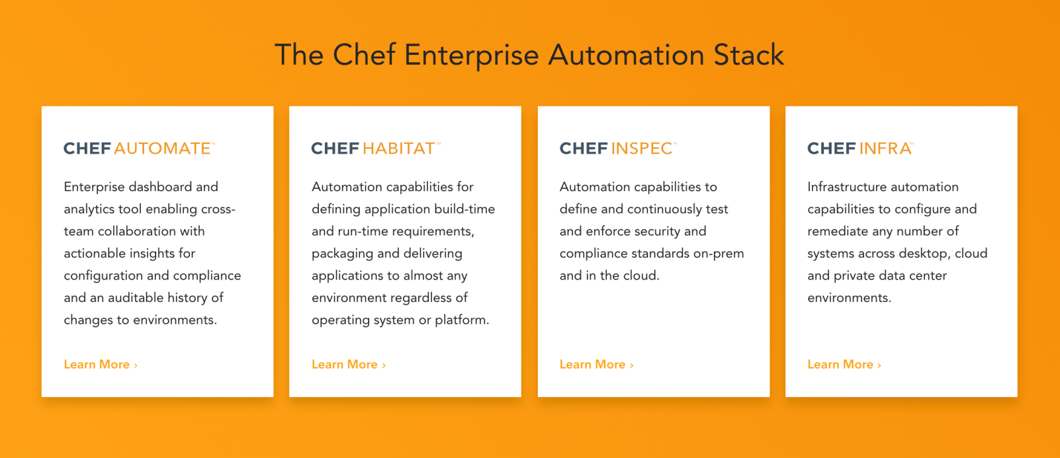
The Enterprise Automate Stack is powered by Chef's core automation engines:
Chef Infra
Chef InSpec
Chef Habitat
Chef Automate

Slide 54
EAS
Chef Enterprise Automation Stack (EAS) provides teams implementing DevSecOps with a common approach for automating application delivery, infrastructure configuration and compliance auditing.

Slide 55
Chef Enterprise Automation Stack Video
https://youtu.be/IBlNQR2nlEY

Slide 56
Learn More
Learn More
Bookmarked
Here is a link to the Learn Chef Tracks page, which includes a recommended progression through the introductory courses on Learn Chef. The Chef Software: A Guided Tour track culminates with the Chef Principles Certification exam: https://learn.chef.io/tracks
If you want to learn how to automate the management of your IT infrastructure, you can start here: Manage Your Fleet with Chef Infra https://learn.chef.io/courses/course-v1:chef+Infra101+perpetual/course/
If you want to learn how to automatically detect and correct compliance failures in your infrastructure, you can start here: Secure Your Infrastructure with Chef Automate https://learn.chef.io/courses/course-v1:chef+Automate101+Perpetual/about
If you want to learn how to test your Chef cookbooks, you can start here: Validate Infrastructure Code with Test Kitchen https://learn.chef.io/courses/course-v1:chef+LocalDev101+Perpetual/course/
If you want to learn how to simplify the auditing and remediation process into a unified workflow using the new Chef Compliance solution, you can start here: Chef Compliance: First Steps with Auditing and Remediation https://learn.chef.io/courses/course-v1:chef+SECCOM101+Perpetual/course/
If you want to learn how to automate the testing of your systems with the Chef InSpec Language, you can start here: Test Expectations with Chef InSpec https://learn.chef.io/courses/course-v1:chef+Inspec101+Perpetual/about
As mentioned above, we offer a Chef Principles Certification exam that will test your knowledge of Chef OSS tools, products, and solutions. Upon passing, you will be awarded with the Chef Principles award, which we encourage you to share on your social networks and with colleagues. The certification will be valid for two years, after which re-certification will be required.
This link will take you to the Chef Principles Certification exam, which includes the recommended courses you can take to pass. https://learn.chef.io/courses/course-v1:chef+CP101+exam/about
SOURCE CHEF.IO

